Slide 1
ER Model Design in ERwin
MIS 634
Business Intelligence & Data Integration - LAB

Slide 2
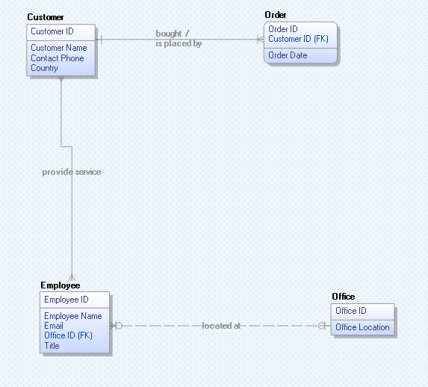
Verb Phrase for Relationship

Slide 3
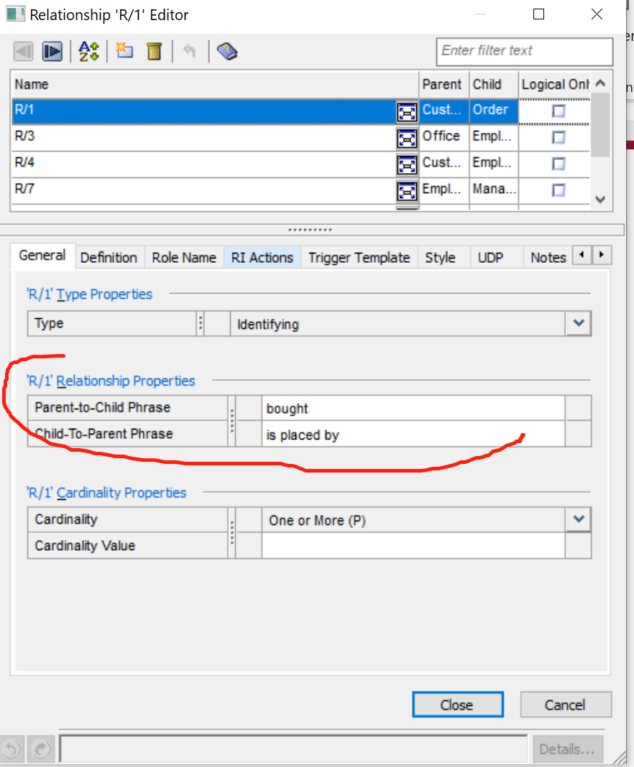
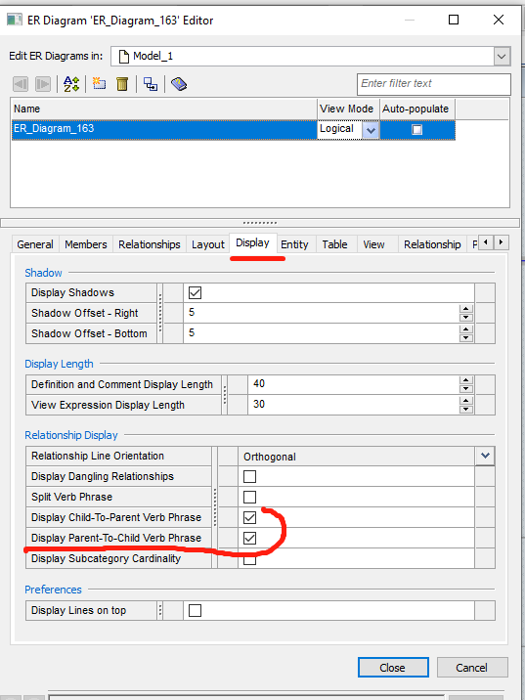
Operation Tip
Describe the relationship
Display the relationship description

Slide 4
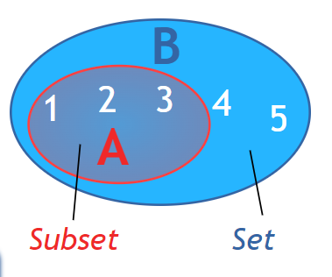
Subtype-Supertype
Supertype is a master entity, subtype is a subset of the supertype
Example:
Supertype: Employee
Subtype: Full-Time
Subtype: Part-Time
Types of Supertype:
IE documents whether the relationship is exclusive or inclusive (IDEF1X is different)
If an employee can only be Part-time or Full-time, but not both → exclusive
If an employee can be Part-time or Full-time, or bot both → inclusive
Discriminator: An attribute of the supertype whose values determine the target subtype

Slide 5
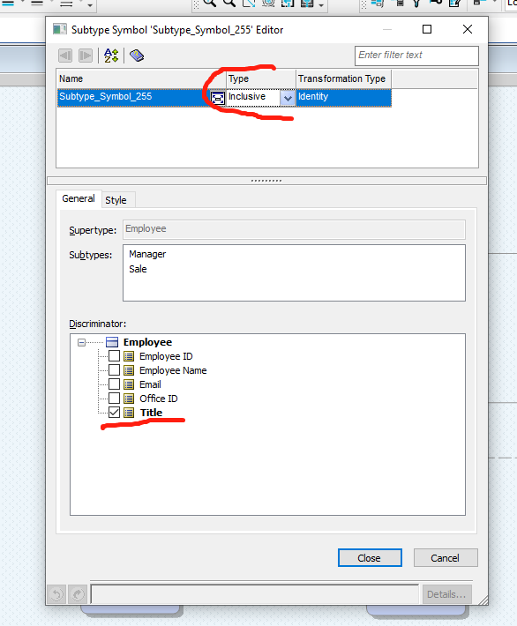
Operation Tip
Right click → “property” → “subtype editor”

Slide 6
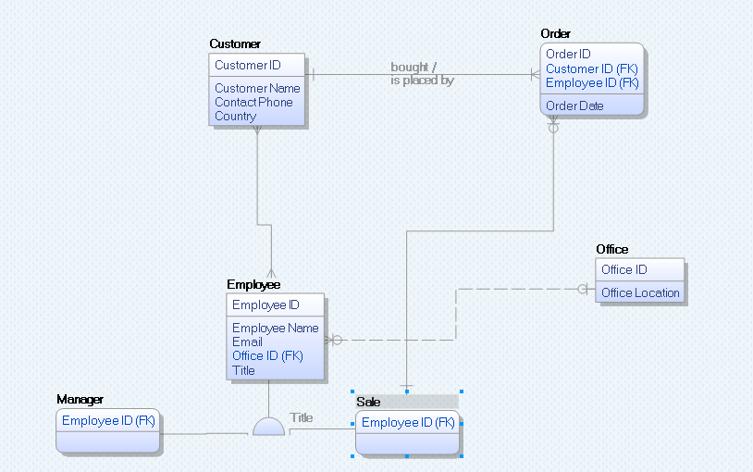
Operation Tip

Slide 7
Types of Data Models - 1
Feature | Conceptual | Logical | Physical
Entity | o | o
Relationship | o | o | o
Attributes |  | o
Primary Key |  | o | o
Foreign Key |  | o | o
Table |  |  | o
Column |  |  | o
(Column) Data Type |  |  | o
ER Diagram | o | o
Data Structure Diagram |  |  | o

Slide 8
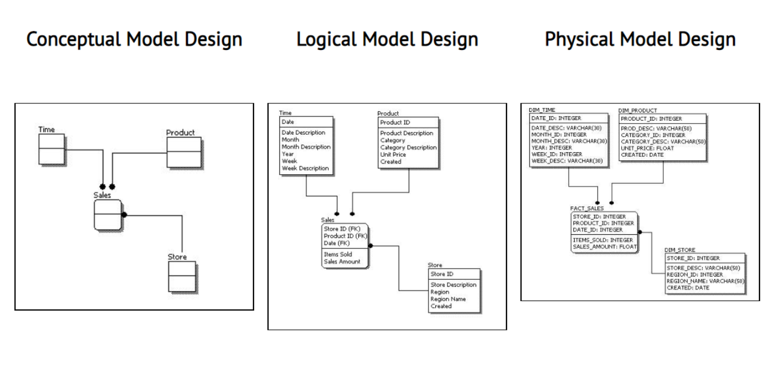
Types of Data Models - 2

Slide 9
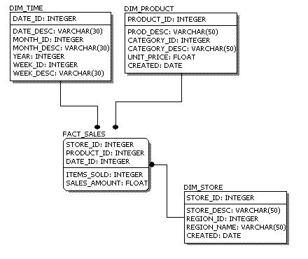
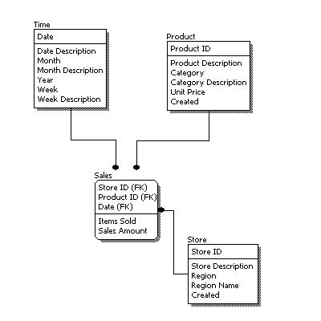
Characteristics of Physical Model
Entity names → table names
Attributes names →column names
“ “(space) change to “_”
Data type for each column is specified
1
2

Slide 10
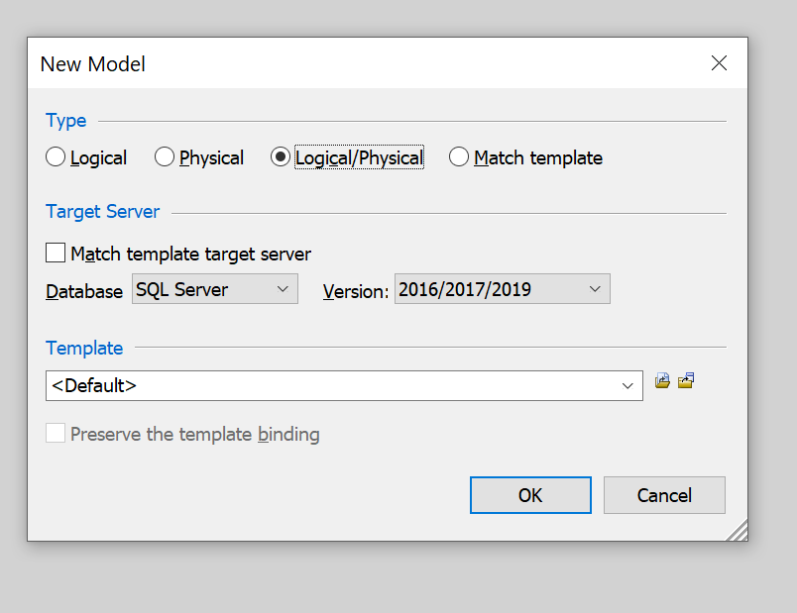
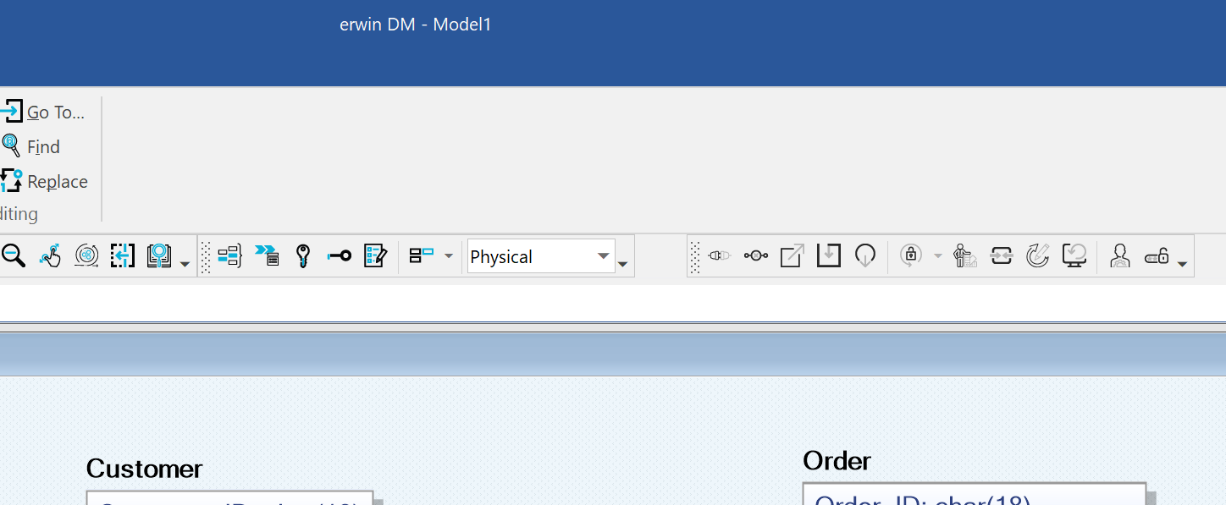
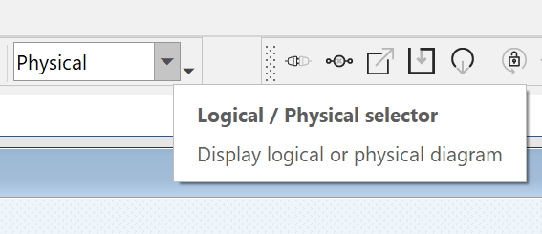
Operation Tips
From logical model to physical model:
When you create a new model, choose the proper “type”
Choose the type as “Logical/Physical”
You can switch the type by “Logical/Physical selector”

Slide 11
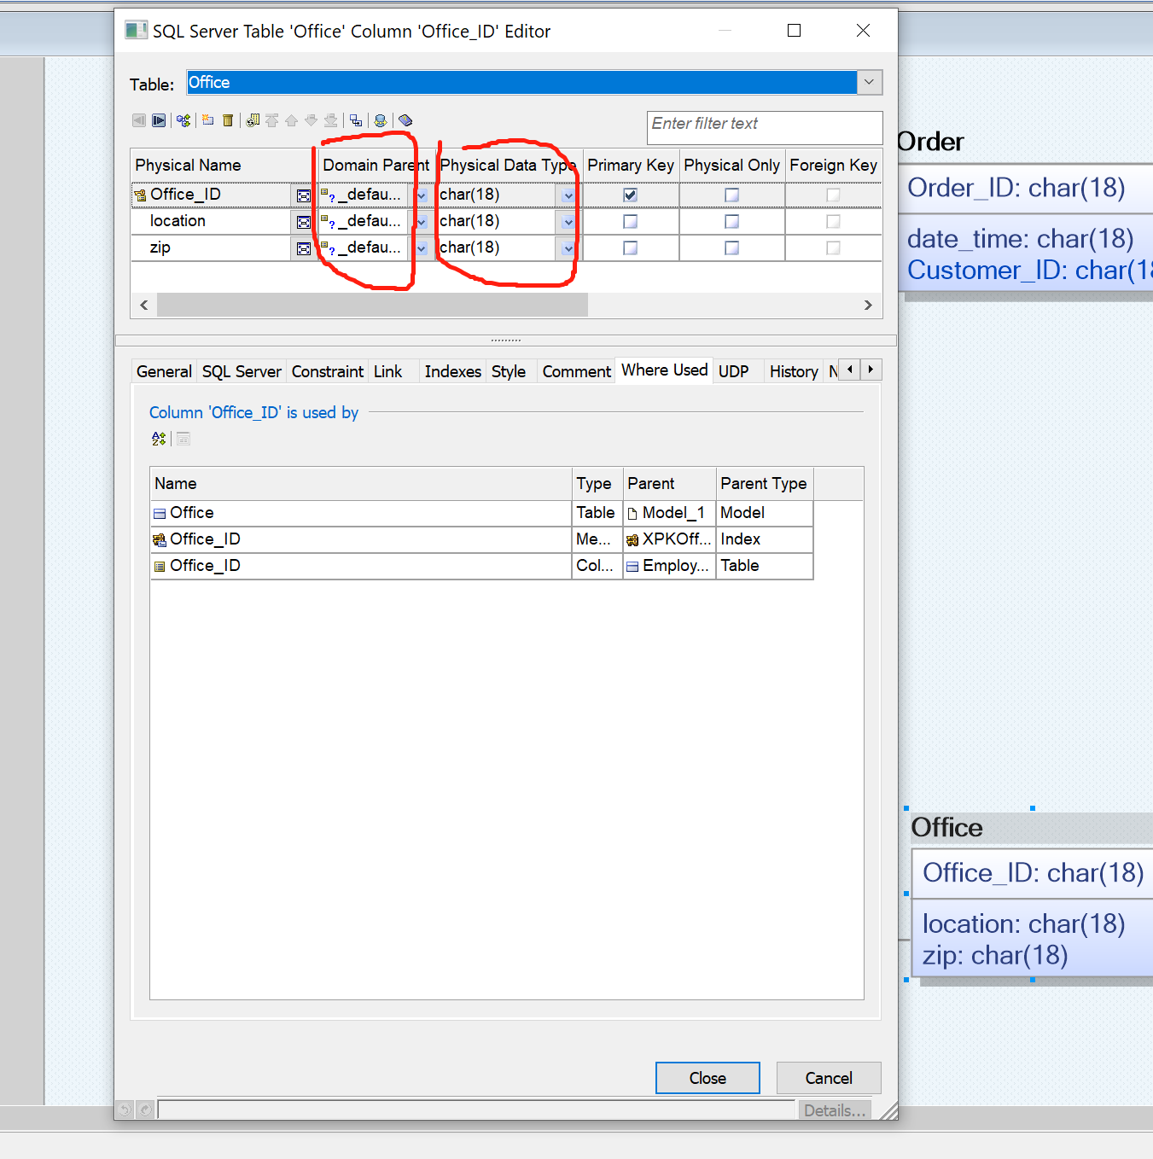
Operation Tips
Define Data Types:
Two ways to define data type in the column property:
Change type in “Physical Data Type”
Change type in “Domain Parent” - 5 pre-defined domains: default (18 alpha and numeric characters) / string / blob / datetime / number
What is Domain? - A domain is a model object that use to assign properties quickly to an attribute or column - Speed up your model building

Slide 12
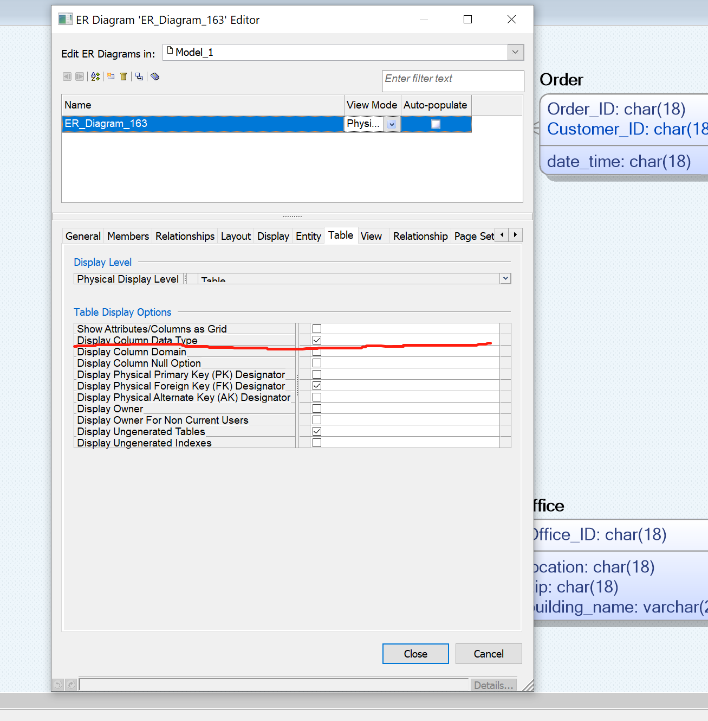
Operation Tips
How to display data type?
-> right click the diagram
-> diagram property
-> “Table” tab
-> check the box of “Display Column Data Type”

Slide 13
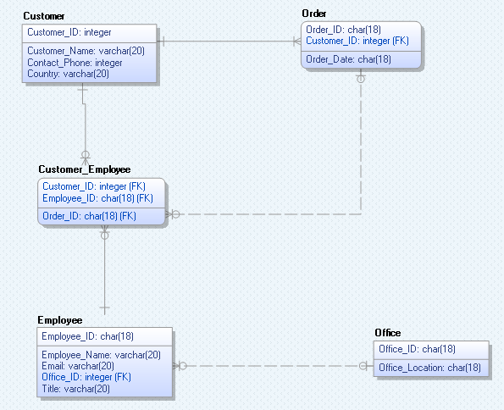
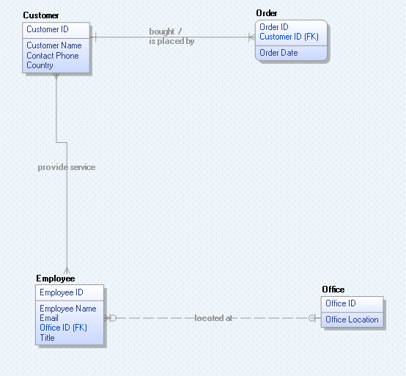
Sample Data Model:
Associative (Join/ Bridge) Table: - Bridges the tables together by referencing
the primary keys of each data table
- Generate automatically by Erwin in physical
model

Slide 14
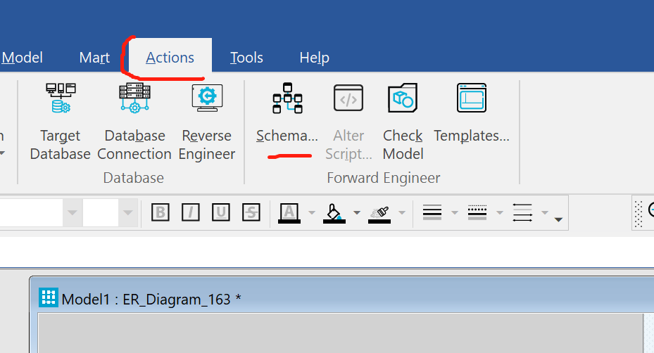
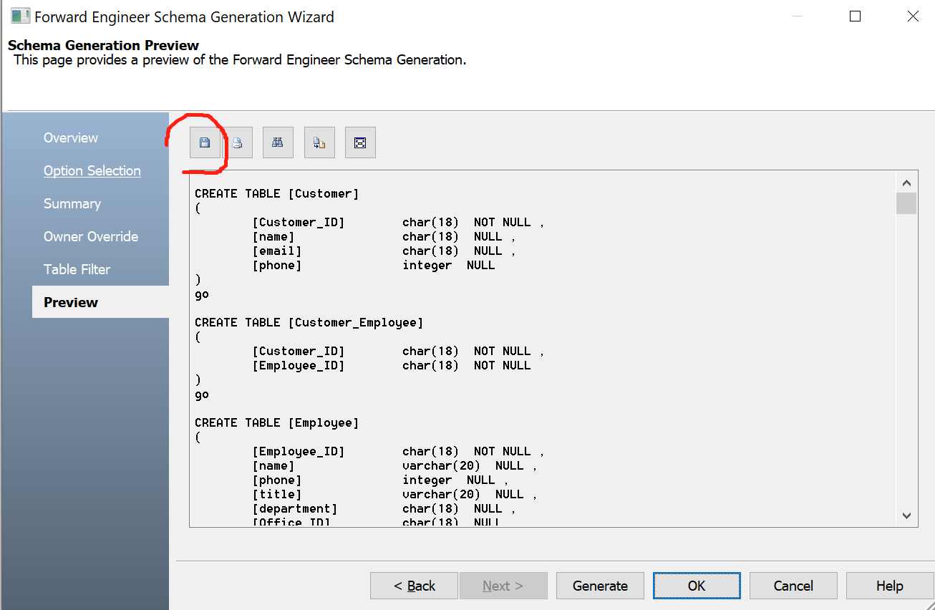
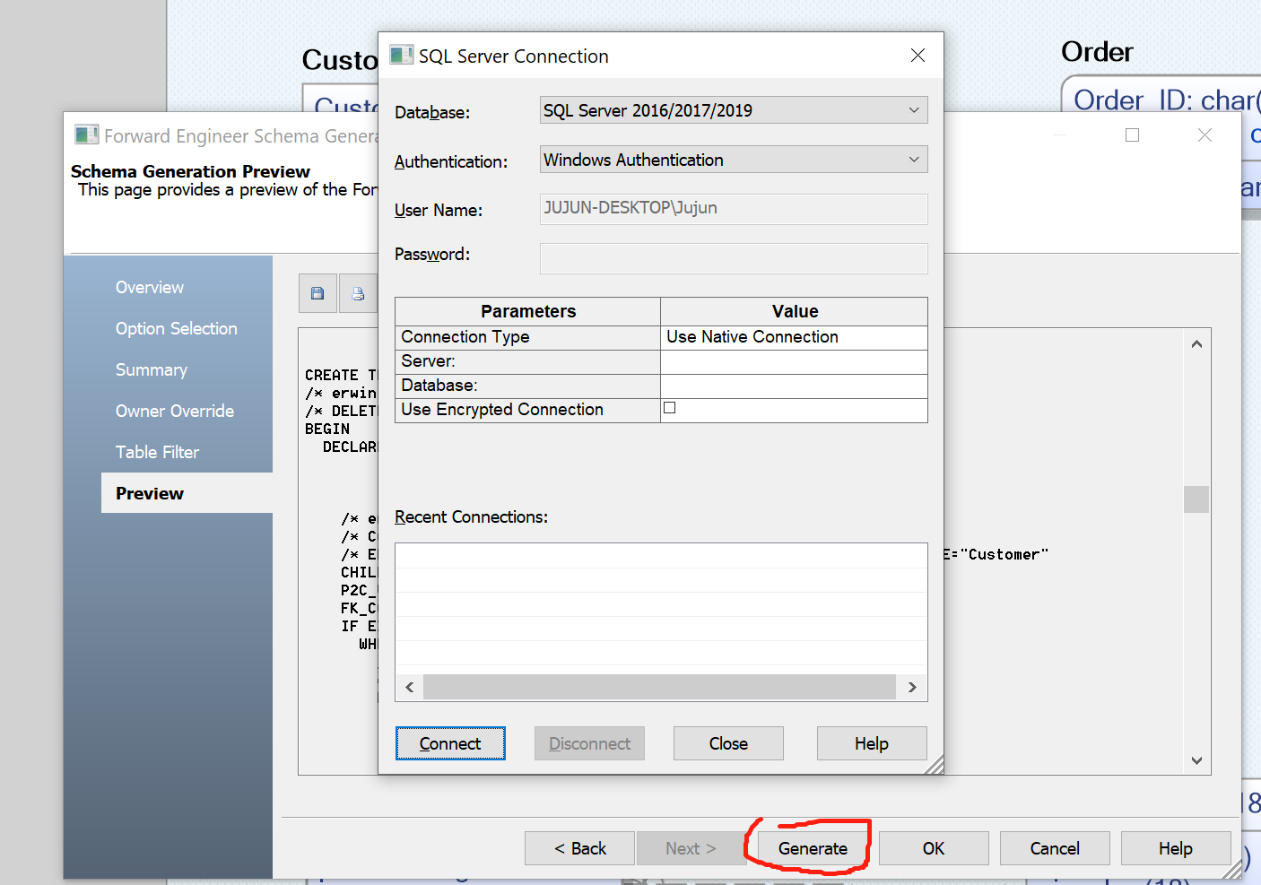
Operation Tips
-> “ Forward Engineer”
-> Schema
-> (1) Get the Data Definition Language (DDL) script (2) Connect to server
More Information about “Forward Engineer” : https://bookshelf.erwin.com/bookshelf/public_html/2020R2/Content/User%20Guides/erwin%20Help/foward_engineering_schema_generation.html
(1)
(2)

Slide 15
Homework 1
Create an ER Diagram for the movie rental stores. The data of this stores contains these information:
employee number, supervisor, employee first name, employee address, employee phone, soc sec number, hire date, salary, movie number, movie title, movie director, description, rating, genre, rental rate, movie url, store number, store manager, store address, store phone, store city, store state, store zip code, rental record date, movie copy number, rental date, due date, rental status, customer number, customer address, email, customer city, customer first name, customer last name, customer state, customer zip code, credit card, credit card exp, status code, store number, payment transaction number, payment type, payment amount, payment date, payment status, check bank number, check number, e-pay vendor number, e-pay account number, credit card number, credit card exp, credit card type
you need to complete an ER Diagram in ERwin. The ER Diagram should have logical model and physical model, and the following objects: the entities, attributes, primary keys, foreign keys, relationships, data type, etc.
Submission: Please submit a screenshot of your ER diagram and the .erwin file.
Extra Reading
Erwin Data Modeler Navigator Edition User Guide

Slide 16
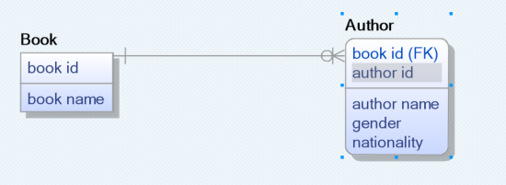
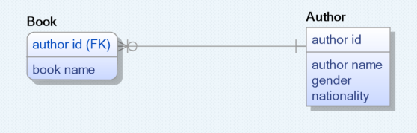
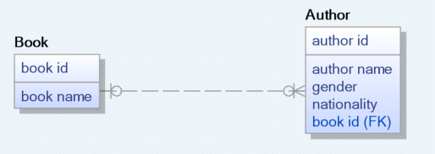
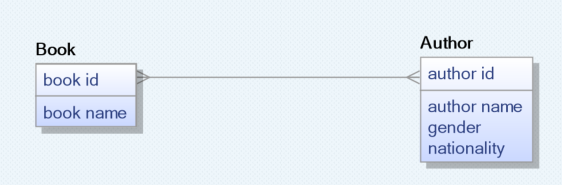
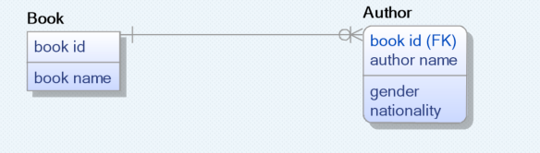
Appendix 1: Question about Relationship Type 1
Book Entity & Author Entity
Which one is the best relationship between these two entities?
→ Normal Forms in DBMS

Slide 17

Appendix 2: Question about Relationship Type 1
Book Entity & Author Entity
May violate 2NF
String
Which one is the best relationship between these two entities?
→ Normal Forms in DBMS

Slide 18
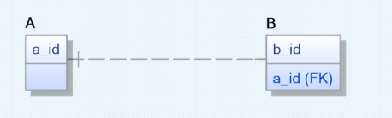
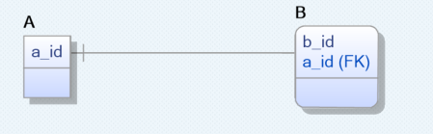
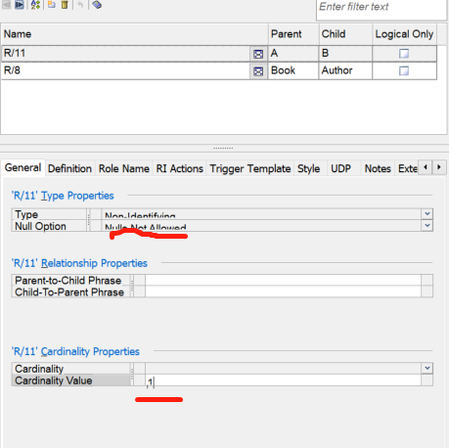
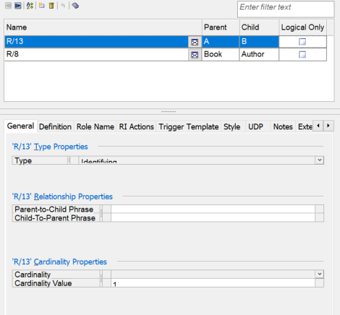

Appendix 3: Question about Relationship Type 2
How to create one to one relationship?

